Slide 1
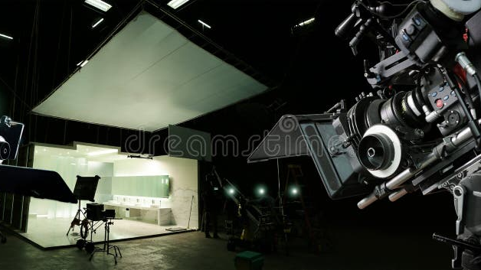
WEEK 1
MULTIMEDIA
PRODUCTION
Overview and Introduction
Academic Year 2025–2026

Slide 2
COURSE OVERVIEW
Contents
01
Course Overview & Introduction
Course objectives, study scheme, multimedia concepts, hypertext, hypermedia, and related key terminology
Week 1 introduces the fundamental concepts of multimedia production.
02
History & Applications of Multimedia
Historical evolution, benefits across industries, real-world examples, and future trends in multimedia
28 slides · 2 chapters

Slide 3
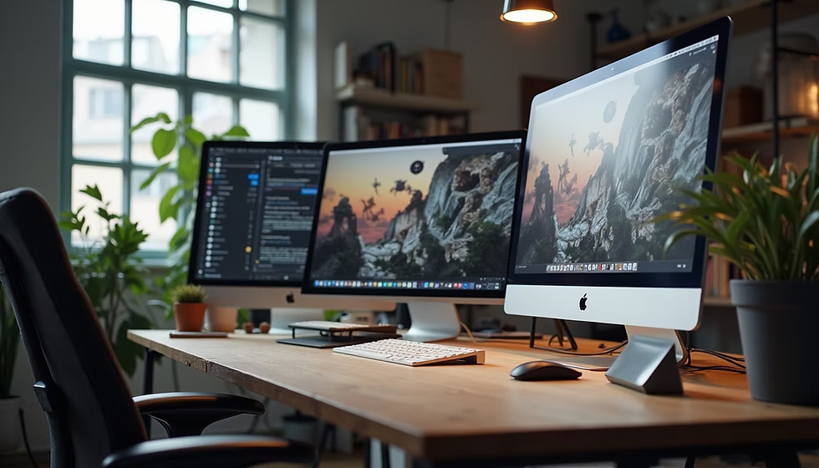
01
COURSE OVERVIEW & INTRODUCTION
Understanding multimedia, hypermedia, hypertext, and related key terms

Slide 4
Course Objectives & Learning Outcomes
By the end of this course, students will be able to:
Understand fundamentals — Grasp the core concepts of multimedia, hypermedia, and hypertext
Identify components — Describe the key elements of multimedia systems
Explain evolution — Trace the historical development of multimedia technology
Analyze applications — Evaluate benefits across education, business, and entertainment
Develop skills — Build foundational multimedia production and design capabilities
04

Slide 5
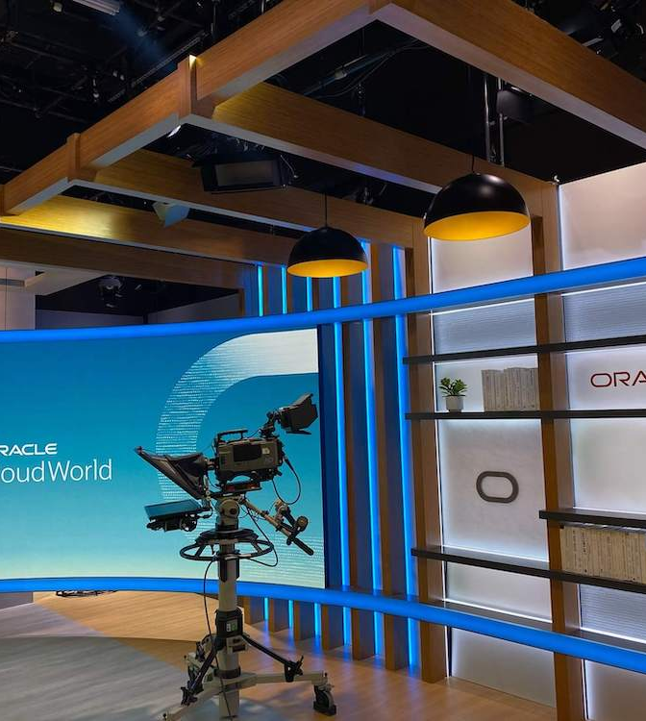
Study Scheme & Course Structure
Weekly Modules
Assessment Breakdown
W1 Overview & Introduction
40%
Assignments
W2–W4 Multimedia Elements
Text, Graphics, Audio, Video, Animation
20%
Mid-term Exam
W5–W8 Multimedia Tools & Software
Editing, authoring, and production tools
40%
Final Project
W9–W12 Design Principles
Visual design, UX, and storytelling
W13–W14 Project & Presentation
Final multimedia project development
Note: Active participation in class discussions and lab sessions is expected throughout the course.
05

Slide 6
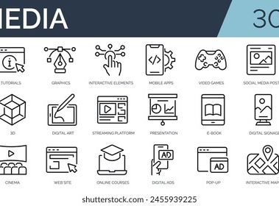
What is Multimedia?
DEFINITION
Multimedia refers to the computer-controlled integration of multiple forms of information content — text, graphics, audio, video, and animation — where every type can be represented, stored, transmitted and processed digitally.
The term "multimedia" literally means "multiple mediums" — using text, images, audio, video, graphics and animation, all or in combination, to communicate information effectively.
Key Insight: A medium refers to different types of data representation. Reading a newspaper (text + images) and watching TV (video + audio) are both multimedia experiences.
Perspectives on Multimedia
Media Student
Presentation, reporting, image editing
Computer Student
Project presentation, simulation
Mobile User
MMS, WhatsApp, social media
PC Vendor
Graphics adapter, sound card
06

Slide 7
Key Characteristics of Multimedia
Integration
Interactivity
Digital Format
Combines multiple media types into a unified, cohesive presentation experience
Users control what information is viewed and when it is viewed
All content is stored, processed, and transmitted in digital form
Non-Linearity
Real-Time Processing
Information can be accessed in any order, not just sequentially
Capable of handling continuous media streams like audio and video
These five characteristics distinguish multimedia from traditional single-media formats and enable rich, engaging digital experiences.
07

Slide 8
Components of Multimedia
Text
Graphics
Audio
Video
Animation
The fundamental element used for labels, menus, buttons, and content delivery
Still images, drawings, diagrams, illustrations, and visual artwork
Sound, music, voice narration, and sound effects for immersion
Moving images, film, live streaming, and motion picture content
Simulated motion through sequential display of still images
Each component plays a distinct role in creating engaging multimedia experiences. Effective multimedia production requires understanding how to combine them harmoniously.
Media Classification
Discrete Media: Text, data, images, graphics — have distinct, separate units
Continuous Media: Audio and video — flow as a stream over time
08

Slide 9
What is Hypertext?
DEFINITION
NON-LINEAR STRUCTURE
Hypertext is text that contains links to other texts, enabling non-linear navigation through information. The term was coined by Ted Nelson around 1965.
Homepage
About
Contact
Unlike traditional linear text read from beginning to end, hypertext allows users to jump between related pieces of information through embedded links called hyperlinks.
Article A
Article B
Article C
How It Works
1. Read
User reads content on a page
2. Click
Clicks a highlighted link
3. Navigate
Jumps to related content
09

Slide 10
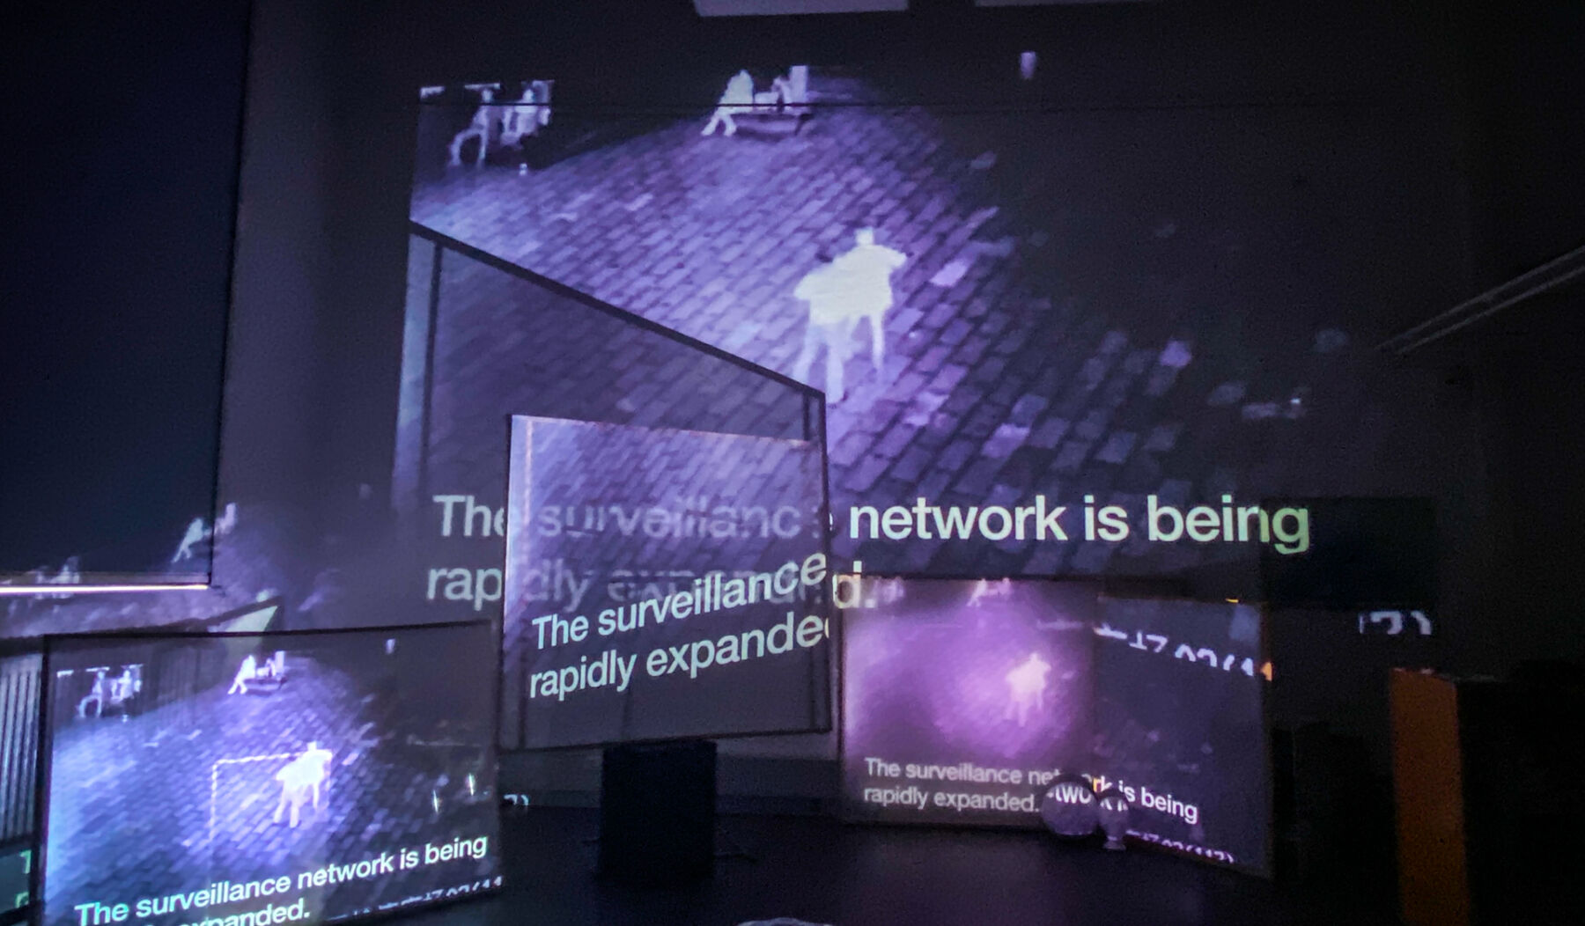
What is Hypermedia?
DEFINITION
Hypermedia is an extension of hypertext that includes graphics, images, audio, video, and animations — not just text-based links.
Hypertext vs. Hypermedia
Hypertext
Hypermedia
Text → Text links only
Linear text with clickable words
Example: Wikipedia article links
VS
Any media → Any media links
Image, video, audio all linked
Example: The entire World Wide Web
Key Example
On an e-commerce site like Amazon, clicking a product image takes you to the product page, which contains videos, reviews, and related items — all interconnected through hypermedia links.
10

Slide 11
Related Key Terms
Interactivity
Linear vs. Non-linear
Synchronous vs. Async
The degree to which users can influence and control the multimedia experience
Sequential playback (like a movie) vs. user-controlled navigation (like a website)
Real-time communication (live video) vs. delayed exchange (email, forums)
Authoring
Rendering
Streaming
The process of creating, editing, and assembling multimedia content using specialized tools
Converting digital data into visible images and audible sound for presentation
Continuous delivery of audio and video media over a network without downloading
Mastering these terms is essential for understanding multimedia literature, tools, and production workflows throughout this course.
11

Slide 12
02
HISTORY & APPLICATIONS
From the printing press to the digital revolution — the evolution of multimedia

Slide 13
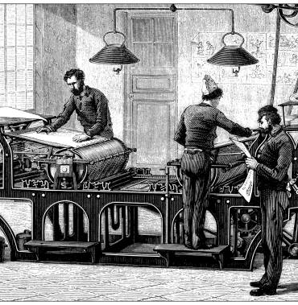
Early Foundations of Multimedia (Pre-1960s)
Milestones that laid the groundwork for modern multimedia
1440
Gutenberg's Printing Press — revolutionized information distribution and mass literacy
1839
Daguerreotype Process — first practical photography, enabling visual documentation
1877
Edison's Phonograph — first device to record and playback sound
1887
Gramophone — enabled mass distribution of audio recordings
1927
First Television Demo — Philo Farnsworth's electronic television transmission
1937
Snow White Film — Disney's first full-length animated feature
13

Slide 14
The Birth of Hypertext (1960s–1970s)
The conceptual foundation of modern linked information
KEY FIGURES
1945
Vannevar Bush — "Memex" Concept
A theoretical machine for storing and linking information, precursor to hypertext
Vannevar Bush
American engineer who conceptualized the Memex, a proto-hypertext system
1965
Ted Nelson Coins "Hypertext"
Invented the term and began the ambitious Xanadu project for a global docuverse
Ted Nelson
Pioneer of information technology who coined "hypertext" and "hypermedia"
1969
ARPANET Launched
The first wide-area packet-switched network, direct precursor to the Internet
Ray Tomlinson
Computer programmer who implemented the first email system on ARPANET
1972
Ray Tomlinson Invents Email
First person to send an email message, transforming electronic communication
"These decades established the theoretical and technological framework for linked digital information."
1974
First Personal Computer (Altair 8800)
Made computing accessible to individuals, setting the stage for multimedia PCs
14

Slide 15
The Digital Revolution (1980s–1990s)
The era when multimedia became practical and widespread
CONVERGENCE FACTORS
1981
IBM PC Introduced — began the personal computing era for homes and offices
Computing Power — CPUs became fast enough to process multiple media types simultaneously
1985
Microsoft Windows — graphical OS made computers user-friendly
Storage Capacity — CDs and DVDs enabled distribution of large multimedia files
1987
Apple HyperCard — brought hypermedia to mainstream Macintosh users
Networking — The Internet connected computers globally for media sharing
1991
World Wide Web — Tim Berners-Lee created the modern Internet
Software Tools — Authoring applications made multimedia creation accessible
1993
Mosaic Browser — first graphical web browser, made the web accessible
GUI Revolution — Graphical interfaces made digital media intuitive to use
1995
DVD Technology — replaced VCRs with superior digital video quality
15

Slide 16
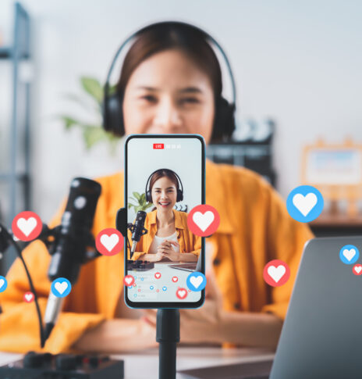
The Internet Era (2000s–Present)
Modern multimedia in the connected world
2004
Facebook — launched social media multimedia sharing globally
2005
YouTube — revolutionized video sharing and user-generated content
2007
Netflix Streaming — transformed entertainment delivery worldwide
2010
Instagram — made visual multimedia communication ubiquitous
2016
TikTok — popularized short-form video content globally
Now
AI, VR/AR — AI-generated content and immersive experiences
16

Slide 17
Evolution Timeline Summary
Four distinct eras of multimedia evolution
PRE-1960s
Individual Media Inventions
Printing Press (1440)
Print, photography, audio recording, television, animation
1960s–1970s
Hypertext (1965)
Conceptual Framework
Hypertext, networking (ARPANET), personal computing, email
World Wide Web (1991)
1980s–1990s
Digital Convergence
PC, World Wide Web, HyperCard, CD-ROM, DVD
YouTube (2005)
2000s–PRESENT
Connected Multimedia
AI & VR Era (Now)
Streaming, social media, mobile, AI-generated content
17

Slide 18

Benefits of Multimedia — Education
Enhanced Engagement
Interactive content captures and maintains student attention longer
Improved Retention
Multi-sensory learning leads to significantly better knowledge retention
Flexible Learning
Students learn at their own pace with non-linear, self-directed content
Accessibility
Content adapted for diverse learning needs and disabilities
Simulation & Practice
Virtual labs provide safe, repeatable learning environments
Global Reach
Online courses make quality education accessible worldwide
18

Slide 19
Benefits of Multimedia — Business & Industry
Marketing & Branding
Training & Development
Communication
Engaging content builds stronger customer connections and brand recognition
Interactive modules improve employee skills efficiently and cost-effectively
Video conferencing and presentations streamline team collaboration
Product Demos
Data Visualization
Global Operations
Multimedia showcases products more effectively than text descriptions
Complex data becomes understandable through charts and infographics
Multimedia transcends language barriers for international business
Multimedia has become an indispensable tool for businesses, enhancing communication, marketing, and overall operations across all industries.
19

Slide 20
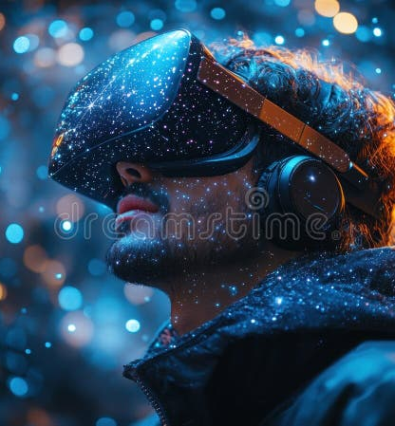
Benefits of Multimedia — Entertainment
Gaming
Immersive experiences combining graphics, audio, and interactivity
Streaming Services
On-demand access to movies, music, and shows anytime, anywhere
Virtual Reality
Fully immersive digital environments for gaming and experiences
Social Media
Platforms built on sharing and consuming multimedia content
Digital Art
New forms of creative expression through digital tools and platforms
Live Events
Concerts and sports enhanced with multimedia effects
20

Slide 21
Benefits of Multimedia — Communication
Social Networking
Video Conferencing
Instant Messaging
Platforms enable rich multimedia sharing globally
Face-to-face communication across any distance
Text, images, audio, and video in real-time
Content Creation
Cross-Cultural
Emergency Alerts
Anyone can create and share multimedia content
Visual media transcends language barriers
Multimedia alerts reach people through multiple channels
Multimedia has fundamentally transformed human communication — making it richer, faster, more visual, and accessible to billions worldwide.
21

Slide 22
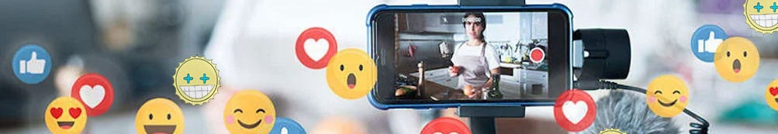
Examples of Multimedia Applications
Real-world multimedia applications across domains
Digital Video Editing
E-Learning Platforms
Video Games
Adobe Premiere, Final Cut Pro for professional film and video production
Coursera, Khan Academy with video lectures, quizzes, and interactive content
AAA titles with cinematic graphics, immersive audio, and real-time gameplay
Digital Signage
Virtual Tours
Medical Imaging
Interactive displays in retail, airports, and public spaces for information
360-degree immersive experiences of real estate, museums, and landmarks
MRI, CT scans with 3D visualization for diagnosis and surgical planning
22

Slide 23
Examples of Hypermedia Applications
Applications leveraging linked multimedia content
World Wide Web
MORE EXAMPLES
The largest hypermedia system connecting billions of pages
Digital Museums — Artifacts linked to historical context and multimedia content
E-Commerce Platforms
Product images linking to reviews, videos, and related items
Smart Documents — PDFs and presentations with embedded links and media
Interactive Encyclopedias
Interactive Maps — Geographic data linked to photos, videos, and information
Wikipedia with cross-linked articles, images, and media
Streaming Platforms — Netflix, Spotify with recommendation algorithms
Learning Management Systems
Connected lessons, quizzes, and resources in one platform
23

Slide 24
Examples of Hypertext Applications
Text-based linking systems in everyday use
Websites & Blogs
Online Documentation
E-Books
Articles linked through clickable references
Manuals with cross-references and links
Digital books with TOC and index links
Legal Databases
Academic Journals
Help Systems
Cases cross-referenced with statutes
Papers citing and linking to research
Software help menus linking to topics
Hypertext is the foundation of modern information navigation. Every click on a website, every cross-reference in a document — that's hypertext at work.
24

Slide 25
Multimedia vs. Hypermedia vs. Hypertext
Understanding the relationship between these three concepts
Dimension | Multimedia | Hypertext | Hypermedia
Definition | Multiple media types combined | Text with links to other text | Any media linked to any other media
Key Feature | Integration of text, graphics, audio, video, animation | Non-linear text navigation via hyperlinks | Non-linear multimedia navigation via hyperlinks
Example | A PowerPoint presentation with slides | Wikipedia article with text links | A website with linked images, videos, and audio
KEY RELATIONSHIP
Hypertext is a subset of Hypermedia, which is an application of Multimedia. All hypermedia is multimedia, but not all multimedia is hypermedia.
25

Slide 26
Future Trends in Multimedia
Emerging directions shaping the future of multimedia
Artificial Intelligence
Augmented Reality
Virtual Reality
360° Video
AI-generated images, video, and audio content creation
Overlaying digital content onto the real world through devices
Fully immersive digital environments for entertainment and training
Spherical video for immersive storytelling and experiences
Real-Time Collaboration
Personalized Content
Holographic Displays
Cloud-based multimedia creation and editing by teams worldwide
AI-driven customization of multimedia experiences per user
3D images projected into physical space without headsets
26

Slide 27
Key Takeaways — Week 1 Summary
1
Multimedia integrates text, graphics, audio, video, and animation into digital experiences
REMEMBER
2
Hypertext enables non-linear navigation through linked text content
"The medium is the message."
— Marshall McLuhan
3
Hypermedia extends hypertext to include all media types with clickable links
4
The history spans from the printing press (1440) to AI-generated content (today)
Next Week:
Multimedia Elements — Text, Graphics, and Audio
We will dive deeper into each component.
5
Multimedia benefits education, business, entertainment, and communication
6
Understanding these fundamentals is essential for multimedia production
27

Slide 28
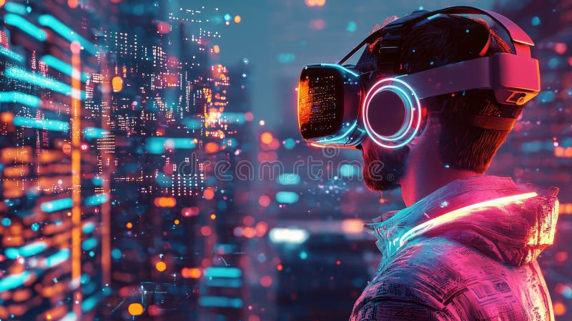
THANK YOU
Multimedia Production — Week 1
"The medium is the message."
— Marshall McLuhan
NEXT WEEK
Multimedia Elements — Text, Graphics, and Audio

